Slide 1


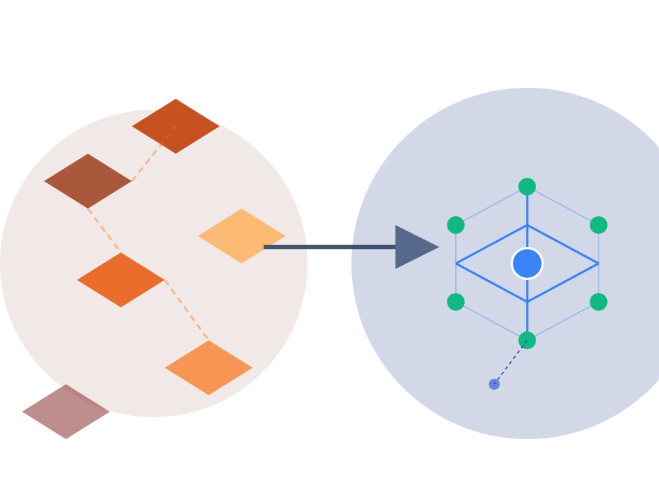


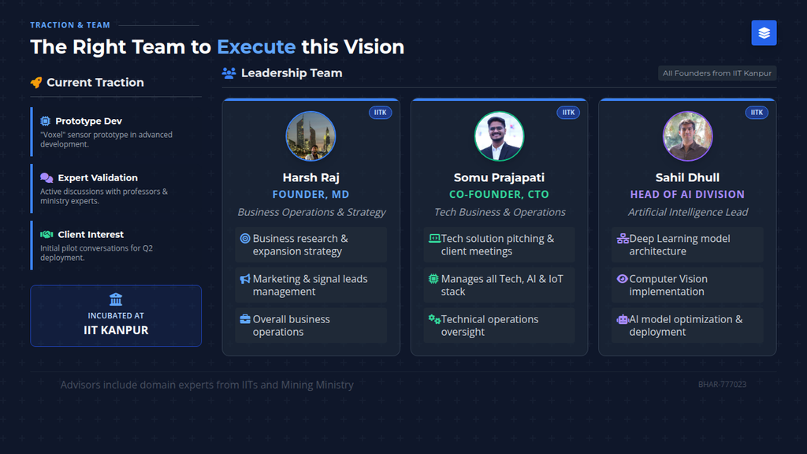
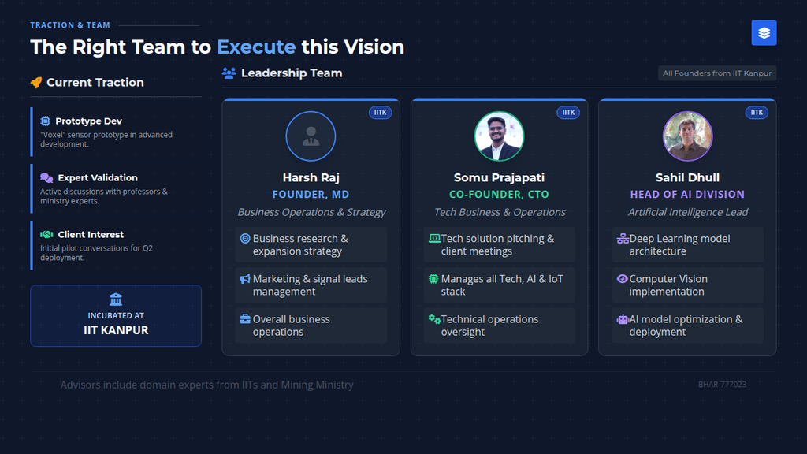
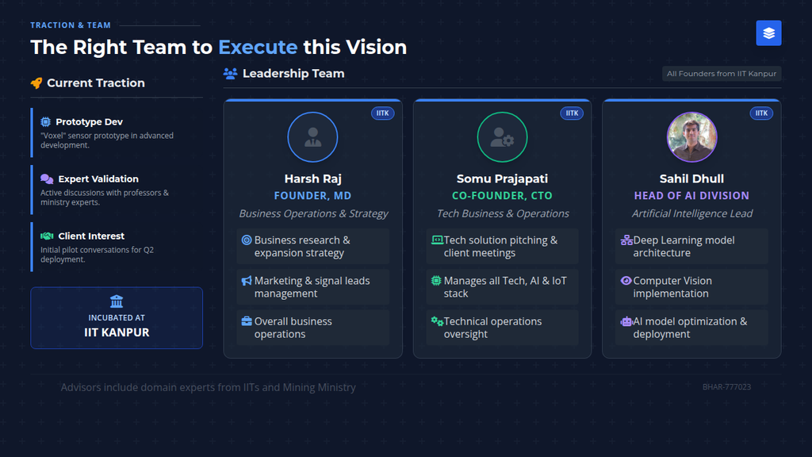




Bharat Innovates
Application Number
PITCH DECK
BHAR-777023
Vyomchara
An Integrated
to Modernize India's
AI Platform
Mining Sector
"India's mining sector is the bedrock of our economy, but it's built on afractured digital foundation. We areVyomchara, and we are building theunified intelligence layerfor the mine of the future."
IIT KANPUR
FOUNDING TEAM
Presented On
Harsh Raj
Somu Prajapati
Sahil Dhull
January 22, 2026
Founder, MD
Co-Founder, CTO
Head of AI

Slide 2








THE PROBLEM
A Trillion-Dollar Industry Running on
Disconnected, Obsolete Technology
The core issue is a lack ofintegrated, end-to-end platforms, creating massive inefficiencies across the mining value chain.
Current State: Fractured Workflow
OFFLINE
SILOED
MANUAL
Data Silos
Geologists, engineers, and operators don't share a single source of truth, leading to misinformed decisions.
?
?
Geology
NO SYNC
Operations
DELAY
Reporting
Exploration Data
Extraction Data
Compliance
High Costs
Expensive foreign technology is unfeasible for most Indian firms, leaving mid-tier miners behind.
Result: 40% Operational Inefficiency & Increased Risk
Safety & Compliance
Manual processes lead to critical safety risks and reporting failures, risking shutdowns.
BHAR-777023
Vyomchara Confidential

Slide 3





















THE SOLUTION
The Vyomchara Platform:
Mining 4.0
An integrated hardware-software stack to Acquire, Analyze, and Act
2
CORE IP
1
3
Analyze
Acquire
Intelligence Layer
Act
Data Collection
Advanced AI leveragingSAM+CNN fusionfor precision.
Execution & Impact
Rapid acquisition via cost-effective drones & sensors.
UnifiedDashboardtransforms data into actionable insights.
Precision segmentation
of minerals
Proprietary
hyperspectral
analysis
Trained on
Indian geological data
Real-time
fleet management
Significant
cost reduction
vs LiDAR
Superior accuracy > global models
Automated
production planning
High-frequency data gathering
Instant
compliance reporting
Proprietary Hardware
AI Architecture
Output Interface
Voxel Sensor
SAM + CNN Fusion
Unified Dashboard
India-Optimized
Contextual Training Data
End-to-End Integration
Real-time Processing
Decision Support
BHAR-777023

Slide 4
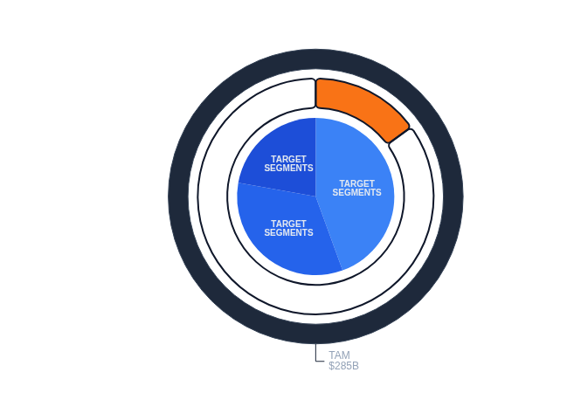








MARKET & OPPORTUNITY
Tapping into India's Massive Mining Potential
Source: Industry Reports 2025
Market Segmentation
Total Available Market (TAM)
$285
Serviceable Addressable Market (SAM)
B
India Metals & Mining Industry 2024
KEY OPPORTUNITY
VYOMCHARA
"No dominant Indian leader in integrated mining technology."
Entry Point
Incumbents like Hexagon and Reactore are too expensive and monolithic for the average Indian firm.
Serviceable Market
$42.75 B
TARGET STRATEGY
15% tech-modernization segment of total output value
Phase 1
Phase 2
Private Contractors
B2G Tenders
2.5%
#2
11.7%
Initial Entry
Scale (Coal India, OMC)
GDP Contribution
Global Coal Producer
CAGR Growth
Source: Ministry of Mines Annual Report 2024-25, Industry Analysis 2025
BHAR-777023

Slide 5
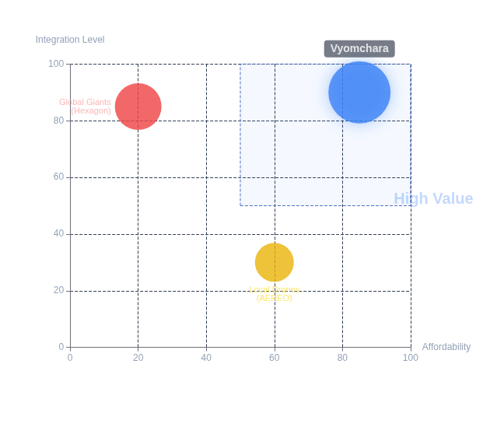



COMPETITION & MOAT
Our Unfair Advantage:
Integration
&
Affordability
Competitive Landscape
Why We Win
System Integration
Seamless hardware-software stack. Hard to replicate end-to-end flow.
Proprietary AI
SAM+CNN models trained specifically onIndian geological data.
Cost Advantage
"Voxel" sensor + affordable drones =1/5th the costof incumbents.
THE COMPETITION
Hexagon / Reactore
AEREO
Vyomchara (Ideal State)
Powerful but monolithic & expensive. Not tailored for India.
Good drone services, but lacks full-stack AI & analytics platform.
Global Giants (Expensive)
Local Niche (Limited)
Analysis based on current market offerings and pilot data
BHAR-777023

Slide 6









BUSINESS MODEL & GO-TO-MARKET
A Dual-Pronged Strategy for
Market Capture
Revenue Model
B2B: Private Sector
B2G: Government
Mid-Tier Mining Contractors
PSUs (Coal India, OMC)
Project Consultancy:Initial digitization & hardware setup fees.
Large Scale Tenders:Multi-year contracts for mine modernization.
Recurring Licensing:SaaS fees for Platform & AI Analytics access.
Enterprise Volume:High-volume data processing & compliance reporting.
Go-to-Market Strategy
1
Pilot Projects
2
Partnerships
3
Scale
Validate ROI & Tech
Expand Reach & Capabilities
Market Dominance
2-3 Paid Pilots
Drone & HW Vendors
B2G Contracts
Strategy focused on low-CAC entry via pilots leading to high-LTV government contracts
BHAR-777023

Slide 7





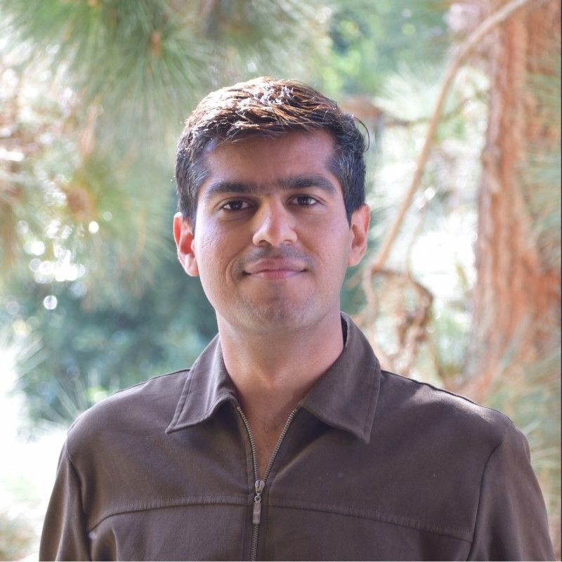












TRACTION & TEAM
The Right Team to
Execute
this Vision
Leadership Team
All Founders from IIT Kanpur
Current Traction
Prototype Dev
IITK
IITK
IITK
"Voxel" sensor prototype in advanced development.
Expert Validation
Harsh Raj
Somu Prajapati
Sahil Dhull
Active discussions with professors & ministry experts.
Founder, MD
Co-Founder, CTO
Head of AI Division
Business Operations & Strategy
Tech Business & Operations
Artificial Intelligence Lead
Client Interest
Business research & expansion strategy
Tech solution pitching & client meetings
Deep Learning model architecture
Initial pilot conversations for Q2 deployment.
Marketing & signal leads management
Manages all Tech, AI & IoT stack
Computer Vision implementation
Incubated at
Overall business operations
Technical operations oversight
AI model optimization & deployment
TEXMiN IIT DHANBAD
Advisors include domain experts from IITs and Mining Ministry
BHAR-777023

Slide 8







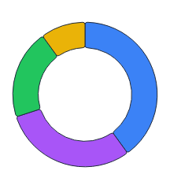
PATH FORWARD
Funding & Milestones:
Momentum & Scale
Traction Secured
OMC
Coal India
₹2.4 Cr
DE-RISKED INVESTMENT
Work Orders From:
Orissa Mining Corp
Maharatna PSU
Raised
CURRENT ROUND ASK
Execution Roadmap
FY 2025-26
₹10
Cr
Q1-Q2 2025
ACHIEVED
₹2.4 CR COMMITTED
₹7.6 CR SEEKING
Foundation & Traction
Secured ₹2.4 Cr seed funding. Onboarded OMC & Coal India. Prototype validation completed.
Allocation Strategy
Q3 2025 (Current)
IN PROGRESS
Deployment & Validation
Deploying pilot projects at OMC sites. Rolling out Fleet Management System for Coal India.
R&D / Product
40%
Q4
Q4 2025
PLANNED
Pilot Expansion
30%
Scale & Enterprise Entry
Scale to 5+ enterprise clients. Demonstrate >15% efficiency gain. First major B2G tender bid.
Operations
20%
BD & Mktg
10%
Q1
Q1 2026
PLANNED
Expansion & Series A Prep
Expand into Metallic Minerals segment. Reach ₹5 Cr ARR run rate.
Tranches released upon milestone completion
BHAR-777023

Slide 9






















STRATEGIC OVERVIEW
Lean Canvas:
Vyomchara
MINING 4.0
PROBLEM
PAIN POINTS
SOLUTION
UNIQUE VALUE PROPOSITION
UNFAIR ADVANTAGE
SEGMENTS
TARGET
Data Silos:
Geology, Ops, and Reporting lack single source.
Voxel Sensor:
Hyperspectral imaging.
INTEGRATED STACK
Private Contractors
"The first unified, affordable Mining 4.0 platform optimized specifically for Indian geology and workflows."
Seamless sensor-to-dashboard.
High Costs:
Incumbents too expensive for mid-tier firms.
Drone Integration:
Auto data.
PROPRIETARY AI
Safety Gaps:
SAM+CNN AI:
Mineral ID.
Trained on Indian geological data.
Mid-tier firms needing efficiency.
Manual surveying leads to risks.
Unified Dashboard:
Insights.
Compliance:
Slow, error-prone manual reporting.
PSUs / Government
End-to-End Integration
Coal India, OMC, NMDC.
KEY METRICS
1/5th Cost of Incumbents
CHANNELS
EPC Firms
Mineral ID Accuracy (%)
Zero-Touch Compliance
Direct Sales (Pilots)
Infrastructure verticals.
Op. Efficiency Gain (%)
Partnerships (Drones)
Deployment Time
GeM Portal (Gov)
Annual Recurring Revenue
Associations (FIMI)
Existing Alternatives
Early Adopters
Manual surveying, Excel sheets, Legacy ERPs.
HIGH-LEVEL CONCEPT
Contractors in Odisha/Jharkhand.
"Android for the Indian Mine"
COST STRUCTURE
REVENUE STREAMS
R&D (HW & AI)
Cloud/Data
Consultancy
Recurring
Hardware
Field Ops
Sales/BD
Pilot Fees
SaaS Licensing
Sensor Sales

Slide 10





















APPENDIX
BHAR-777023
Technical Architecture:
End-to-End Logic Flow
CONFIDENTIAL
RAW DATA (PB)
CLOUD INFRASTRUCTURE
PROCESSED (TB)
INTELLIGENCE (GB)
ACTIONABLE INSIGHTS
FIELD
EDGE
DASHBOARD
INTEGRATIONS
Voxel Sensor
CORE IP
Hyperspectral
Data Lake
ERP/MES
PROPRIETARY
Raw & Curated
Interactive Maps
Drone Fleet
Pre-processing
Real-time Visualization
Autonomous
AI PIPELINE
GIS
Geo-tagging &
Compression
Inference API
Deep Learning Engine
IoT Gateway
User Auth
SAM + CNN Fusion
ML Ops
Telemetry
Fleet Mgmt
Compliance
Gov Portal
Security & Governance LayerFoundation
INDIAN DATA
End-to-End Encryption • Role-Based Access Control (RBAC) • Immutable Audit Logs
RESIDENCY COMPLIANT
ISO 27001 Ready

